Slide 1



Computer System Management CT012-3-3 CSM
Presented by:
Aryan Maharjan NP000563
Lecturer:
Mr. Ramesh Suwal

Slide 2
SWOT Analysis on Buddha Air
SWOT Analysis is a strategic use of plans and technique which helps to determine the overall evaluation of both internal and external findings
STRENGTH | WEAKNESS
Reputed brand known for quality services in Nepal. Modern infrastructure and technology Broad range of Services Safety Record | Limited International Presence Competition Aging of Equipment
OPPORTUNITY | THREAT
International Expansion Use of Modern Equipment Tourism Growth | Natural Disasters Price Competition Increased Fuel Price Emerging Technologies

Slide 3
Strengths
their brand reputation for best civil aviation service available in the market.
a huge number of successful flights throughout the country
Opportunities
expand their connectivity by providing international airline services
attracting the customers by providing best customer experience during the service period

Slide 4
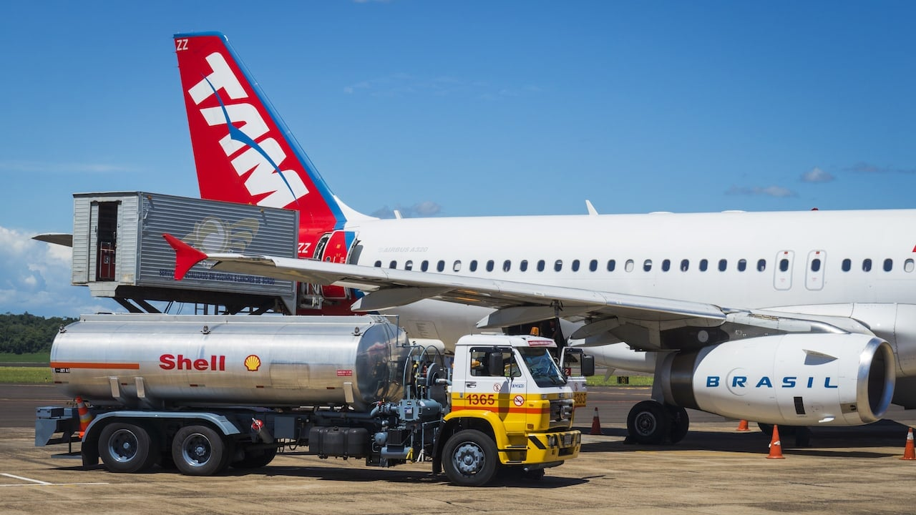
Threats
natural disasters like earthquake, hurricane or storms, or flood which can affect or ground the service
fuel price increment

Slide 5

Major Weaknesses And Solutions
Weakness
Limited International Presence
Aging of Equipment
Recommended Solution
Cost Leadership
Differentiation Strategy

Slide 6

Possible Security Threats and their Solutions on Overseas Market Expansion
Hostile Competitors:
When a company enters a new country, they are exposed to a new set of competitors which have their own new strategies.
Solution:
plan and conduct proper research of the environment along with the existing competitors
invest in pricing strategy to stay strong and stand out against wars on competitors price wars

Slide 7

Possible Security Threats and their Solutions on Overseas Market Expansion
Data Privacy and Cybersecurity Threats:
might face several cybersecurity threats and data privacy threats due to cyber-attacks
Solution:
invest in security measures such as encryption, firewall protection, intrusion detection system
train their staffs regularly to improve their skills

Slide 8
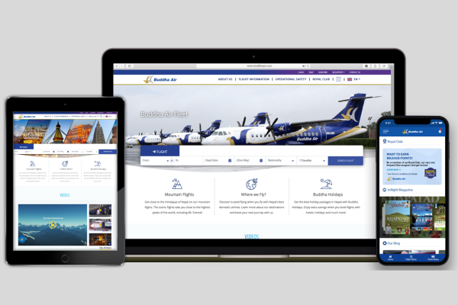
IT as Supply Chain Enabler
E-business / Electronic Online Processes
real-time insights of the supply chain
services availability
keep track of all the equipment, along with how the different aircrafts are functioning and their locations

Slide 9
IT as Supply Chain Enabler
Electronic Data Exchange (EDI)
allows exchanging the documents such as invoices, shipment billing, and purchase orders
reduce human errors, maximize the efficiency of the processes and reduce the manual requirement of data input

Slide 10

IT as Supply Chain Enabler
Internet
helps to connect the company with all the bodies involved in the supply chain
replace the traditional face-to-face market and unlocks the new right-to-your-door-step service from the click of a button

Slide 11
Thank you!

